Slide 1
Micro Credit PPT
A PowerPoint presentation containing problem statement and understanding, EDA steps and visualizations, Steps and assumptions used to complete the project, model dashboard, finalized model, and conclusion.

Slide 2
Problem Statement
A Microfinance Institution (MFI) is an organization that offers financial services to low income populations. MFS becomes very useful when targeting especially the unbanked poor families living in remote areas with not much sources of income. The Microfinance services (MFS) provided by MFI are Group Loans, Agricultural Loans, Individual Business Loans and so on.
Many microfinance institutions (MFI), experts and donors are supporting the idea of using mobile financial services (MFS) which they feel are more convenient and efficient, and cost saving, than the traditional high-touch model used since long for the purpose of delivering microfinance services. Though, the MFI industry is primarily focusing on low income families and are very useful in such areas, the implementation of MFS has been uneven with both significant challenges and successes.
Today, microfinance is widely accepted as a poverty-reduction tool, representing $70 billion in outstanding loans and a global outreach of 200 million clients.
We are working with one such client that is in Telecom Industry. They are a fixed wireless telecommunications network provider. They have launched various products and have developed its business and organization based on the budget operator model, offering better products at Lower Prices to all value conscious customers through a strategy of disruptive innovation that focuses on the subscriber.

Slide 3
They understand the importance of communication and how it affects a person’s life, thus, focusing on providing their services and products to low income families and poor customers that can help them in the need of hour.
They are collaborating with an MFI to provide micro-credit on mobile balances to be paid back in 5 days. The Consumer is believed to be defaulter if he deviates from the path of paying back the loaned amount within the time duration of 5 days. For the loan amount of 5 (in Indonesian Rupiah), payback amount should be 6 (in Indonesian Rupiah), while, for the loan amount of 10 (in Indonesian Rupiah), the payback amount should be 12 (in Indonesian Rupiah).
The sample data is provided to us from our client database. It is hereby given to you for this exercise. In order to improve the selection of customers for the credit, the client wants some predictions that could help them in further investment and improvement in selection of customers.

Slide 4
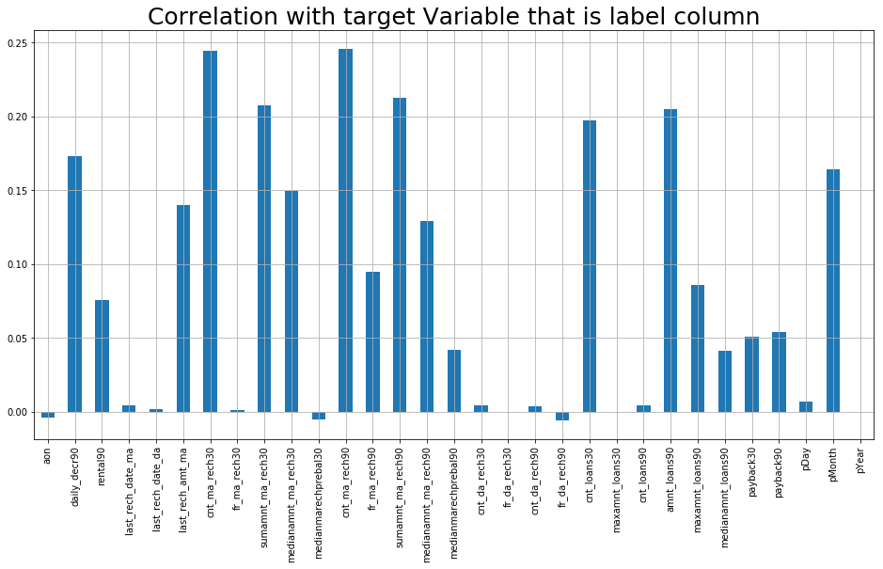
Data Visualization

Slide 5
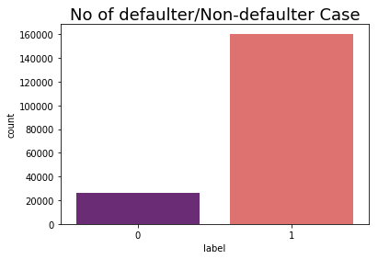
Observation 1 - Here we see the correlation of the columns with respect to the target column that is label

Slide 6
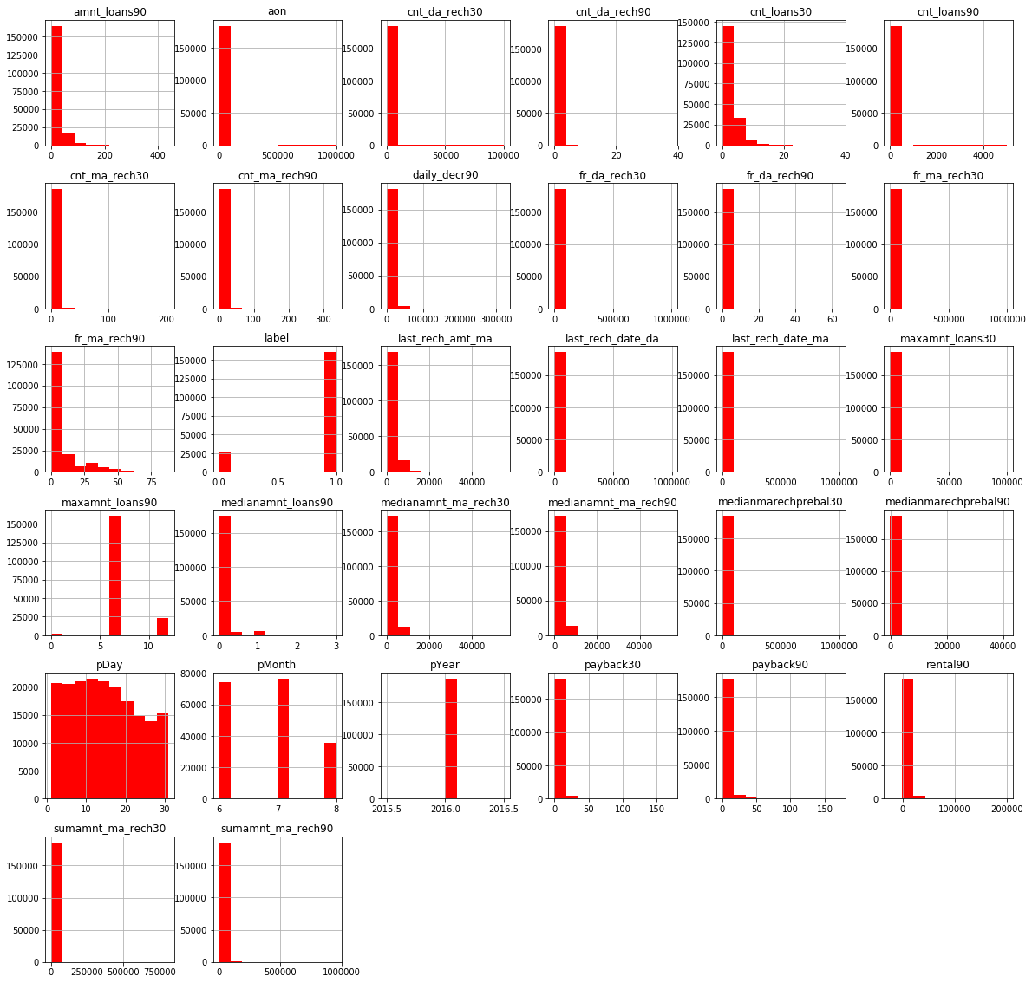
Observation 2 - Label 1 indicates loan has been payed i.e. Non-Defaulter and label 0 indicates that the loan has not been payed i.e. defaulter.

Slide 7
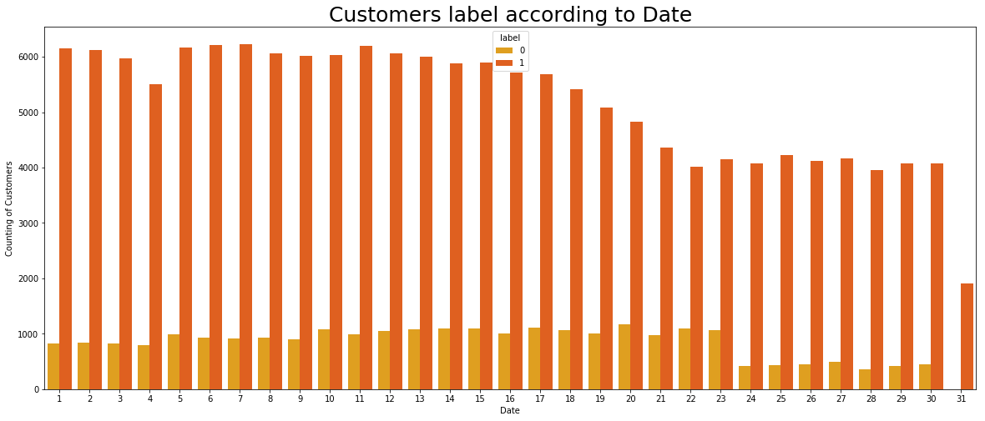
Observation 3 - We plot the histogram to display the shape and spread of continuous sample data. In a histogram, each bar groups numbers into ranges. Taller bars show that more data falls in that range

Slide 8
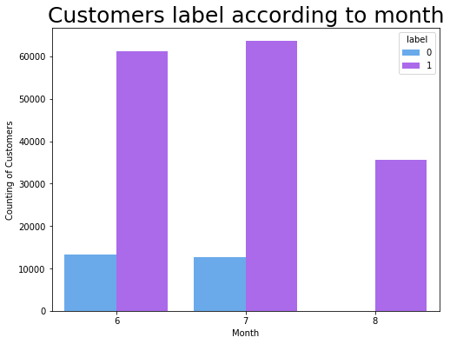
Customer Label according to month

Slide 9
Model’s Training
Model’s used for the classification and regression

Slide 10
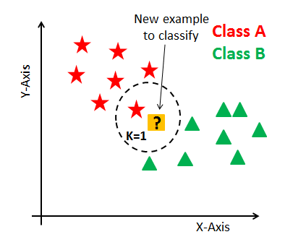
1. K Nearest Neighbors(KNN) -
K Nearest Neighbor(KNN) is a very simple, easy to understand, versatile and one of the topmost machine learning algorithms. KNN used in the variety of applications such as finance, healthcare, political science, handwriting detection, image recognition and video recognition. In Credit ratings, financial institutes will predict the credit rating of customers. In loan disbursement, banking institutes will predict whether the loan is safe or risky. In political science, classifying potential voters in two classes will vote or won’t vote. KNN algorithm used for both classification and regression problems. KNN algorithm based on feature similarity approach.

Slide 11
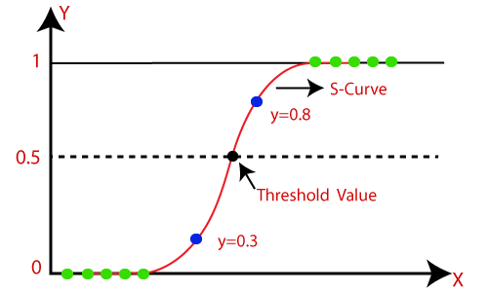
2. Logistic Regression -
Logistic regression is one of the most popular Machine Learning algorithms, which comes under the Supervised Learning technique. It is used for predicting the categorical dependent variable using a given set of independent variables.
Logistic regression predicts the output of a categorical dependent variable. Therefore the outcome must be a categorical or discrete value. It can be either Yes or No, 0 or 1, true or False, etc. but instead of giving the exact value as 0 and 1, it gives the probabilistic values which lie between 0 and 1.
Logistic Regression is much similar to the Linear Regression except that how they are used. Linear Regression is used for solving Regression problems, whereas Logistic regression is used for solving the classification problems.
In Logistic regression, instead of fitting a regression line, we fit an "S" shaped logistic function, which predicts two maximum values (0 or 1).

Slide 12

3. Decision Tree Classification Model –
Decision Tree is a Supervised learning technique that can be used for both classification and Regression problems, but mostly it is preferred for solving Classification problems. It is a tree-structured classifier, where internal nodes represent the features of a dataset, branches represent the decision rules and each leaf node represents the outcome.
In a Decision tree, there are two nodes, which are the Decision Node and Leaf Node. Decision nodes are used to make any decision and have multiple branches, whereas Leaf nodes are the output of those decisions and do not contain any further branches.
The decisions or the test are performed on the basis of features of the given dataset.
It is a graphical representation for getting all the possible solutions to a problem/decision based on given conditions.

Slide 13
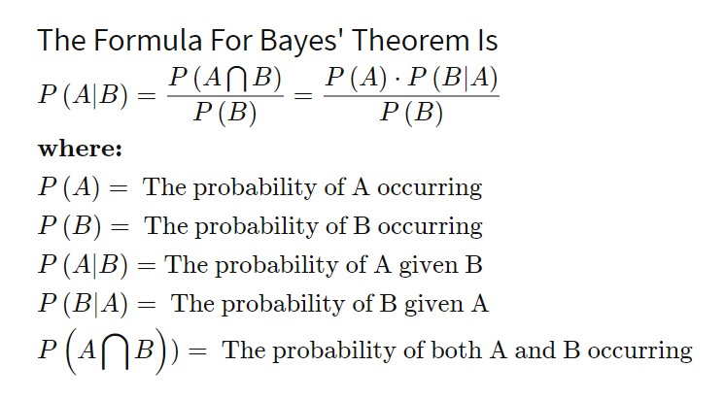
4. Gaussian NB(Naïve Bayes) Model –
Gaussian is a variant of Naïve Bayes that follows Gaussian normal distribution and supports continuous data. Naive Bayes are a group of supervised machine learning classification algorithms based on the Bayes theorem. It is a simple classification technique, but has high functionality. They find use when the dimensionality of the inputs is high. Complex classification problems can also be implemented by using Naive Bayes Classifier.

Slide 14
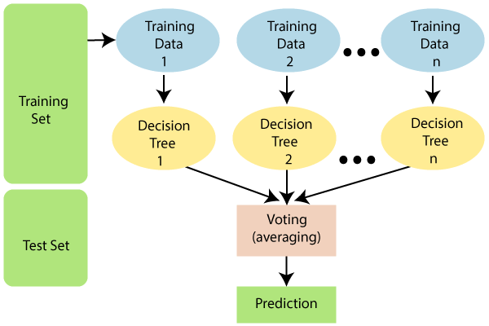
5. Random Forest Model –
Random Forest is a popular machine learning algorithm that belongs to the supervised learning technique. It can be used for both Classification and Regression problems in ML. It is based on the concept of ensemble learning, which is a process of combining multiple classifiers to solve a complex problem and to improve the performance of the model.
As the name suggests, "Random Forest is a classifier that contains a number of decision trees on various subsets of the given dataset and takes the average to improve the predictive accuracy of that dataset." Instead of relying on one decision tree, the random forest takes the prediction from each tree and based on the majority votes of predictions, and it predicts the final output.
The greater number of trees in the forest leads to higher accuracy and prevents the problem of overfitting.

Slide 15
Conclusion
So here 'Decision Tree Classifier Model' is the best model out of all model tested above and by looking this we can conclude that our model is predicting around 92% of correct results for Label ‘0’ indicates that the loan has not been payed i.e. defaulter.

